Slide 1
ROUTING ALGORITHMS
ROUTING ALGORITHM
ROUTER
DESIRABLE PROPERTIES OF A ROUTING ALGORITHM
CLASSIFICATION OF ROUTING ALGORITHMS
THE OPTIMALITY PRINCIPLE
SINK TREE
ROUTING PROTOCOL
ROUTING PROTOCOL FUNCTIONS
DYNAMIC ALGORITHMS
DISTANCE VECTOR ROUTING ALGORITHM
DISTANCE VECTOR ROUTING PROTOCOL
ROUTING INFORMATION PROTOCOL – RIP

Slide 2
ROUTING ALGORITHM
A part of the network layer software responsible for deciding which output line an incoming packet should be transmitted on.
If the subnet uses datagrams internally, this decision must be made anew for every arriving data packet since the best route may have since last time.
If the subnet uses virtual circuit internally, routing decisions made only when a new virtual circuit is being set up. Thereafter the data packets just follow the previously established route. This is sometimes called as SESSION ROUTING because a route remains for an entire user session.

Slide 3
ROUTER
A router is composed of two processes:
Forwarding: A process that handles each packet as it arrives, looking up the outgoing line to use for it in the routing tables.
Routing Algorithm: A process that is responsible for filling in and updating the routing tables.

Slide 4
DESIRABLE PROPERTIES OF A ROUTING ALGORITHM
Correctness
Simplicity
Robustness
Stability
Fairness
Optimality

Slide 5
CLASSIFICATION OF ROUTING ALGORITHMS
Routing algorithms can broadly be classified in 2 ways:
Based on whether they are centralized or decentralized
- Centralized routing algorithms
- Decentralized routing algorithms
Based on whether they are static or dynamic.
  Static routing algorithms
  Dynamic routing algorithms

Slide 6
CENTRALIZED ROUTING ALGORITHMS
- Also called as GLOBAL routing algorithm.
- Computes the least cost path between a source and destination using complete, global knowledge about the network.
The computation itself can be run at one site or replicated at multiple sites.
A global algorithm has complete information about connectivity and link costs.
- Algorithms with global state information are often referred to as link state algorithms, since the algorithm must be aware of the state (cost) of each link in the network.

Slide 7
DECENTRALIZED ROUTING ALGORITHMS
  Calculation of the least cost path is carried out in an iterative, distributed manner.
  No node has complete information about the costs of all network links.
  Each node begins with only knowledge of the costs of its own directly attached links and then through an iterative process of calculation and exchange of information with its neighboring nodes gradually calculates the least cost path to a destination, or set of destinations.
  A decentralized routing algorithm is known as a distance vector algorithm.

Slide 8
STATIC ROUTING ALGORITHMS
Static algorithms are those algorithms that do not depend on measurements or estimates of the current traffic and topology.
The choice of the route is computed in advance (offline) and downloaded to the routers when the network is booted.
This procedure is also called as NON ADAPTIVE ROUTING.
Ex: Shortest path routing, flooding, etc

Slide 9
DYNAMIC ROUTING ALGORITHMS
Dynamic algorithms are those algorithms that change their routing decisions to reflect changes in the traffic and topology.
These algorithms differ in the following ways,
Where they get the information
- Locally from adjacent routers or from all routers
When they change their routes
- Every ∆T sec, when the load changes or when the topology changes
What metric is used for optimization
- Number of hops, geographical distance, transmission delay, bandwidth, average traffic, mean queue length, communication cost, etc
This procedure is also called as ADAPTIVE ROUTING.
Ex: Distance Vector Routing, Link State Routing, etc

Slide 10
THE OPTIMALITY PRINCIPLE
It states that
“If router B is on the optimal path from router A to router C, then the optimal path from B to C also falls along the same route”.

Slide 11
SINK TREE
The set of optimal routes from all sources to a given destination form a tree rooted at the destination. Such a tree is called a SINK TREE.
A sink is not necessarily unique.
The goal of all routing algorithms is to discover and use the sink trees for all routers.

Slide 12
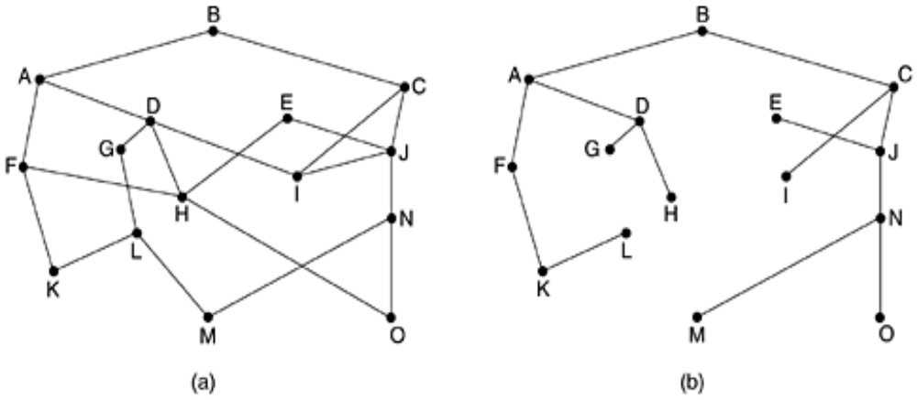
SINK TREE
The below figure represents (a) A subnet and (b) its corresponding Sink tree

Slide 13
ROUTING PROTOCOL
Routing protocol is a protocol that defines a set of messages, rules and algorithms used by routers for the overall purpose of learning routes.
This process includes exchange and analysis of routing information.
Each router chooses the best route to each subnet and finally places those best routes into its routing table.
Ex: RIP, EIGRP, OSPF and BGP.

Slide 14
ROUTING PROTOCOL FUNCTIONS
Learn routing information from other neighboring routers.
Advertise routing information to other neighboring routers.
If more than one possible route exists to reach the subnet , pick the best route based on a metric
Convergence: If the network topology changes (a link fails), advertise this change all others routers and then pick a new currently best route.

Slide 15
ROUTING PROTOCOL ALGORITHM
It refers to the algorithm used by different routing protocols
to solve the problem of learning all routes
choosing the best route to each subnet
convergence.

Slide 16
DYNAMIC ALGORITHMS
The most popular dynamic algorithms are
Distance vector routing
Link state routing

Slide 17
DISTANCE VECTOR ROUTING ALGORITHM
Other names:
The Distributed Bellman-Ford routing algorithm (Bellman, 1957)
The Ford- Fulkerson algorithm (Ford and Fulkerson, 1962)
Why the name DISTANCE vector?
Because a node never actually knows a complete path from source to destination.
It only knows the direction (which neighbor) to which it should forward a packet in order to reach a given destination along the least cost path, and the cost of that path from itself to the destination.

Slide 18
DISTANCE VECTOR ROUTING ALGORITHM
Operation:
Each router maintains a routing table indexed by, and containing one entry for, each router in the subnet.
This entry contains two parts:
The preferred outgoing line to use for that destination
An estimate of the time or distance to that destination.
The metric used might be number of hops; time delay in milliseconds; total number of packets queued along the path, etc

Slide 19
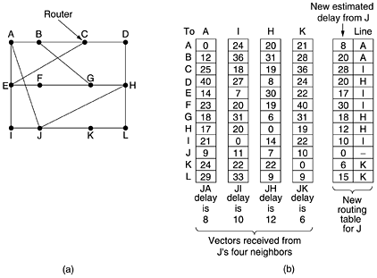
DISTANCE VECTOR ROUTING ALGORITHM
The below figure shows (a) A subnet, (b) show the delay vectors received from the neighbors of router J.
A claims to have a 12-msec delay to B, a 25-msec delay to C, a 40-msec delay to D, etc.
Suppose J has measured or estimated its delay to its neighbors, A, I, H, and K as 8, 10, 12 & 6 ms, resp.

Slide 20
DISTANCE VECTOR ROUTING ALGORITHM
Computation of J’s new route to router G:
Case 1: Via A
J can get to A in 8 ms and A claims to get to G in 18 ms, so J can count on a delay of 26 (8 + 18) ms to G.
Case 2: Via I
J can get to I in 10 ms and I claims to get to G in 31 ms, so J can count on a delay of 41 (10 + 31) ms to G.
Case 3: Via H
J can get to H in 12 ms and H claims to get to G in 6 ms, so J can count on a delay of 18 (12 + 6) ms to G.
Case 4: Via K
J can get to K in 6 ms and K claims to get to G in 31 ms, so J can count on a delay of 37 (6 + 31) ms to G.
The least of all cases is 18.
Therefore, J makes an entry in its routing table that the delay to G is 18 msec and that the route to use is via H.

Slide 21
DISTANCE VECTOR ROUTING PROTOCOL
These protocols advertise a small amount of simple information about each subnet to their neighbors.
Their neighbors in turn advertise the information to their neighbors, and so on, until all routers have learned the information.
This process continues in a periodic basis.
Distance vector protocols send full updates each time they send a regular periodic routing update.
So these routing updates are called PERIODIC FULL ROUTING UPDATES.

Slide 22
DISTANCE VECTOR ROUTING PROTOCOL
As long as there is no change with the same metrics, there is no change in the routers routing table. When change occurs, the routers react and converge to use the new best working routes.
Distance vector protocols must define a METRIC that determines how good each is. The metric represents a distance from a router to a subnet.
Features:
Simple
Uses little bandwidth
Designed to send only little information

Slide 23
ROUTING INFORMATION PROTOCOL – RIP
RIP is a distance vector routing protocol.
RIP sends periodic routing updates every 30 seconds by default.
Metric Used: Hop Count
Hop Count: The number of routers or hops between a router and the destination subnet.
Metric considered to be “infinite” : 16
RIP response message:
Routing updates are exchanged between neighbors approximately every 30 seconds using a so-called RIP response messages.
Also known as RIP advertisements.

Slide 24
ROUTING INFORMATION PROTOCOL – RIP
Example:
Consider an internetwork with 8 routers that uses RIP as a distance vector routing protocol.
Routing update
R2
R3
R4
X,4
X,3
Subnet X
R1
R5
R6
R8
X,2
R7

Slide 25
ROUTING INFORMATION PROTOCOL – RIP
Router R1 learns 3 separate routes to reach subnet X namely
4- hop route through R2 (through routers R2, R3, R4 and R8)
3-hop route through R5 (through routers R5, R6 and R8)
2-hop route through R7 (through router R7)
R1 picks the two-hop route through R7 because it has the lowest metric

Slide 26
ROUTING INFORMATION PROTOCOL – RIP
Why the name Distance VECTOR?
Through this whole process, from R1’s view, R1 received 3 messages from its neighboring routers (R2, R5 and R7), a subnet and a metric for each competing route.
The information learned by R1 can be graphically represented as,
R2
To R2, 4 hops
R1
To R2, 4 hops
R5
Subnet
To R7, 2 hops
R7

Slide 27
ROUTING INFORMATION PROTOCOL – RIP
Reason:
The vectors length is the distance (metric) to reach a subnet
The vectors direction is the next hop router
Versions:
Version 1 – RFC 1058
Version 2 – RFC 2453 (backward-compatible version)

Slide 28
EXERCISE
Consider the subnet given below. Distance vector routing is used, and the following vectors have just come in to router C: From B: (5, 0, 8, 12, 6, 2); from D: (16, 12, 6, 0, 9, 10); from E: (7, 6, 3, 9, 0, 4). The measured delays to B, D and E are 6, 3 and 5 respectively. What is C’s new routing table? Give both the outgoing line to use and the expected delay.
B
C
A
D
F
E

